Slide 1
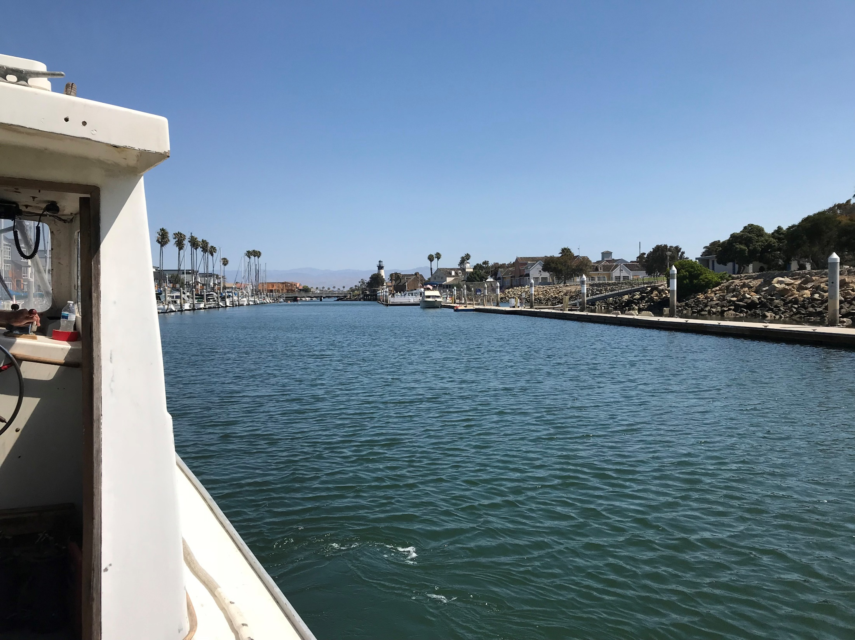
Channel Islands Harbor
Water Quality Update
October 22, 2018

Slide 2
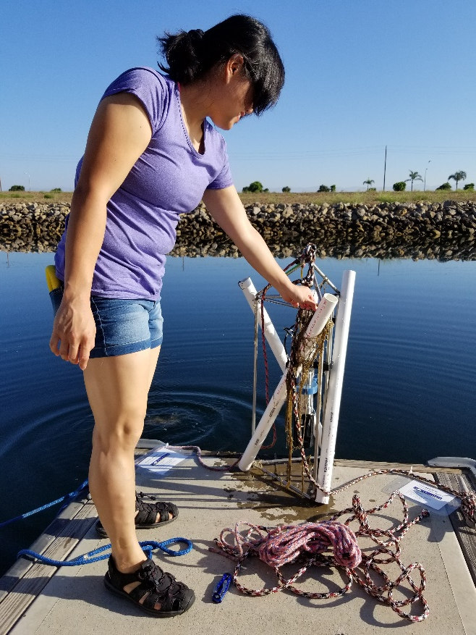
Tonight’s Presentation
Introduction
Plan and Timeline
Scientists Update
Commonly Asked Questions
Nutrient Sources & Sinks
Prepare for Emerging Problems
Community Response Plans
Community Meetings

Slide 3
2018 Activities To Date
June
15
City staff began receiving calls about water quality at the Channel Islands Harbor
18
City staff sampled water to test for bacteria, nitrogen and phosphorus
20
City staff began water sampling for dissolved oxygen, temperature, pH and salinity
23
Bacteria testing results confirmed water is safe for human contact

Slide 4
2018 Activities To Date
July
5
City Council approved contract with Marine Biologist and Scientist
11
City provided update at Channel Islands Harbor Task Force Meeting
26
Aerators were installed at Seabridge Public Marina

Slide 5
2018 Activities To Date
Aug
1
Weekly sampling of Phytoplankton and Chlorophyll began
6
1st remote sensor was installed in Seabridge at location #24
20
City staff met with Ventura County Watershed Protection District to discuss water quality regulatory program

Slide 6
2018 Activities To Date
Sep
12
Order was placed for 3 remote sensors
13
City staff and community members advocated for the delay of the termination of the NRG NPDES permit, but the Regional Water Quality Control Board approved the termination without delay
20
City staff began discussions with scientists for nutrient study

Slide 7
2018 Activities To Date
Oct
1
City staff began taking baseline nutrient samples
2
City Council approved release of the Seabridge escrow funds ($250,000) and expenditures totaling $68,930
17
Councilmember Perello met with Senator Hannah-Beth Jackson and Assemblywoman Monique Limón to secure state and federal support opportunities

Slide 8
2018 Plan and Timeline
Oct
24
Conference call with Regional Water Quality Control Board staff to coordinate efforts around nutrient study
Nov
Results of Oct. baseline nutrient sampling
Installation of 3 remote sensors
1st rain event (pending) – nutrient sampling
City to apply for Ocean Protection Council grant

Slide 9
2018/19 Plan and Timeline
Dec
Begin sediment sampling
Begin Hydrology Study
Jan
Results of Nov. nutrient sampling
2nd rain event (pending) – nutrient sampling

Slide 10
2018/19 Plan and Timeline
Feb
Results of Dec. sediment sampling
Mar

Slide 11
2018/19 Plan and Timeline
Apr
Preliminary report and recommendations (dependent upon rain events)
Results of Hydrology Study
Jun
Final nutrient and hydrology report with recommendations of options
More steps to follow…

Slide 12
Planned Long Term Activities
Upcoming:
Initiate community response planning January 2019
Establish early warning communications regarding water quality events
Establish the long-term Monitoring Plan to inform the early warning communications (above).
City to continue exploring potential grants and funding sources

Slide 13
Scientists Update:
Dr. David A. Caron
Professor of the Department of Biological Sciences, USC (since 1999)
Chief Science Officer of Aquatic EcoTechnologies, LLC
Ph.D. in Biological Oceanography conferred jointly by MIT and the Woods Hole Oceanographic Institution
250 scientific articles and book chapters on the ecology of microbes in marine and freshwater systems
Mr. Scott C. Johnson
Senior Scientist/Laboratory Director, Aquatic Bioassay & Consulting Laboratories, Inc.
M.S. in Marine Biology
California State University Long Beach
Notes:
Consultants take over

Slide 14
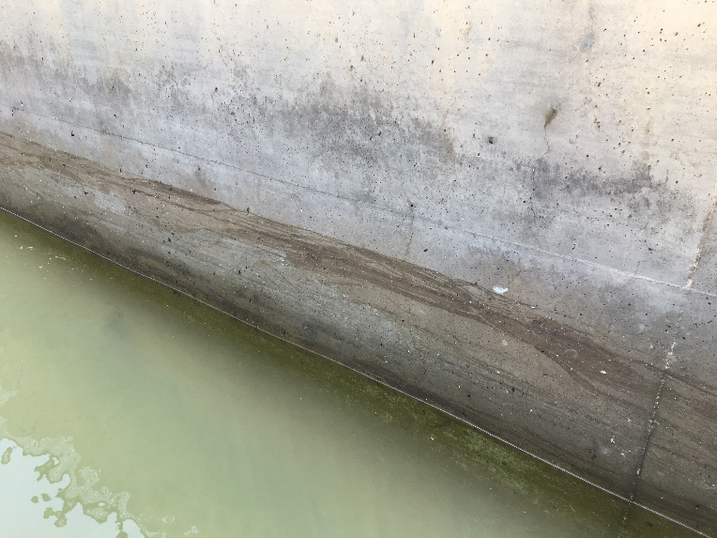
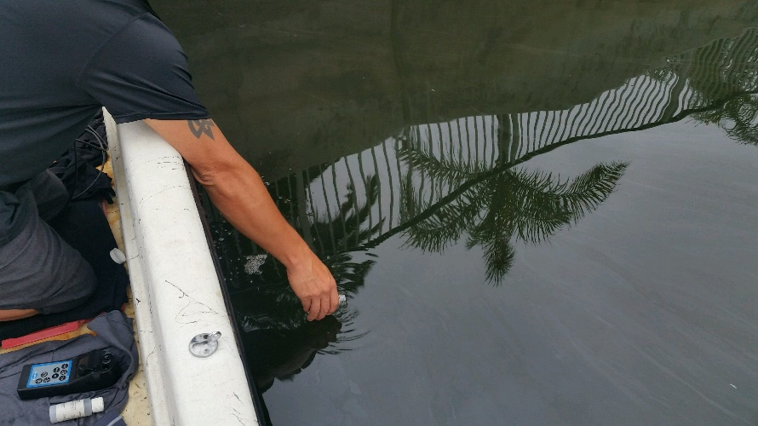
The Problem
“Dark murky water” in Channel Islands Harbor reported by the public beginning in late June
Present throughout back basins, especially at Seabridge and Westport

Slide 15
Commonly Asked Questions
What are the initial steps?
The City, along with us, are investigating to determine the causes. This must be a data-driven process (diagnosis is necessary before treatment).

Slide 16
Commonly Asked Questions
What are the primary causes of the problem?
This is what the investigation will determine.
There is no simple answer. There are multiple possible causes and/or influences affecting water quality. It is also likely the problem is a combination of interacting issues, rather than just one or two.

Slide 17
Commonly Asked Questions
Why can’t we turn the power plant pumps back on?
The Los Angeles Regional Water Quality Control Board terminated the NPDES discharge permit for operation of those pumps on Sep. 13, 2018.
Once thru cooling pumps are being phased out by the State Water Resources Control Board.
Notes:
Be sure to say what NPDES stands for

Slide 18
Commonly Asked Questions
What is the long-term plan to solve the issue?
The approach must be cause-dependent.
We first need to learn the sources of nutrients and hydrologic dynamics of harbor.
We need to understand Harbor water quality so that we can develop options to address this in the long term.

Slide 19
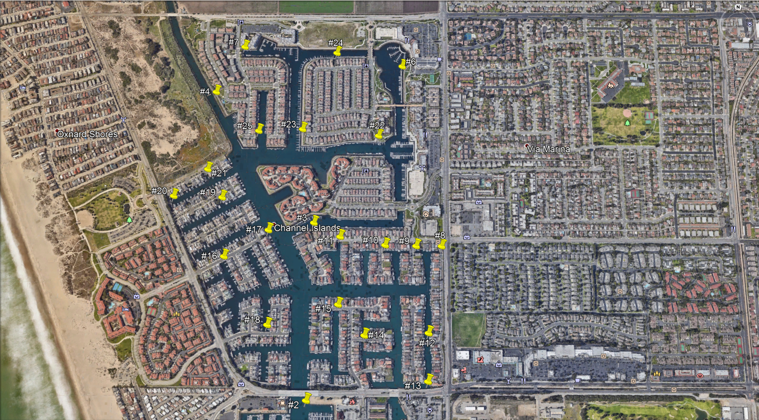
Water Sampling
Locations

Slide 20
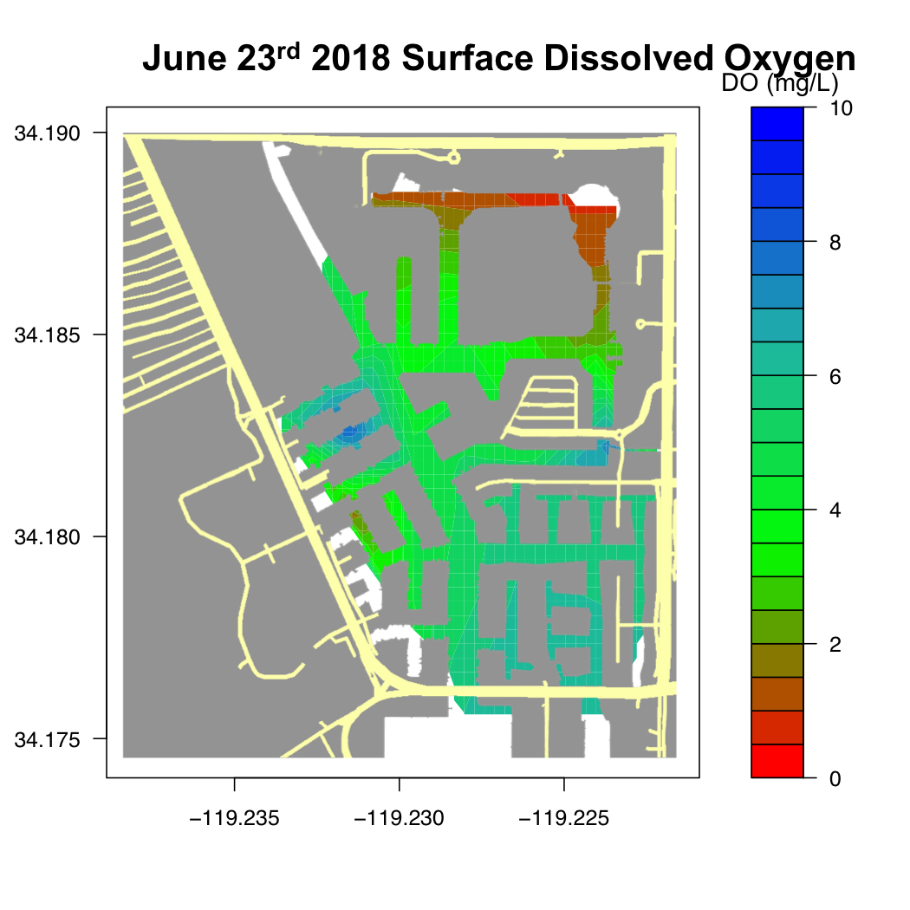

Slide 21
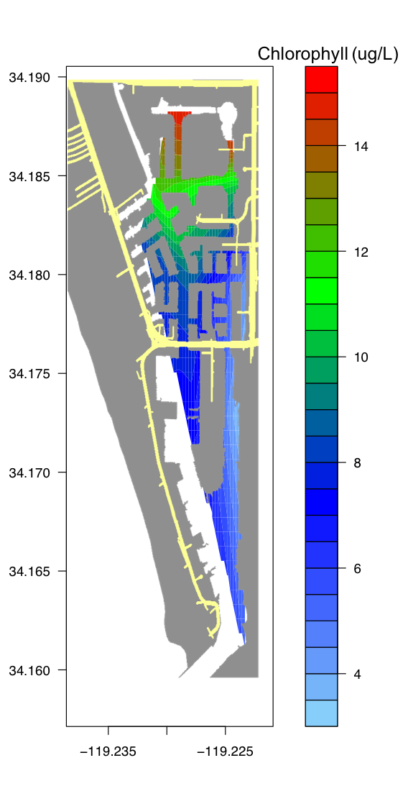
July 6, 2018 Results

Slide 22
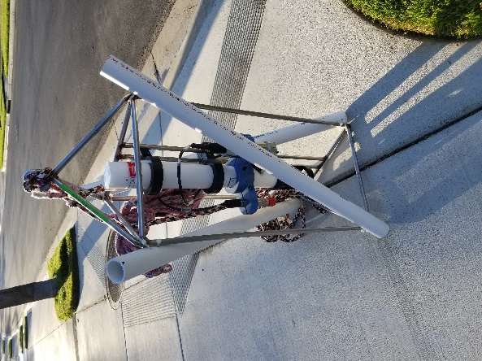
Notes:
Be sure to mention this sensor is on loan so they understand later on that there will only be 4 sensors total, not 5

Slide 23
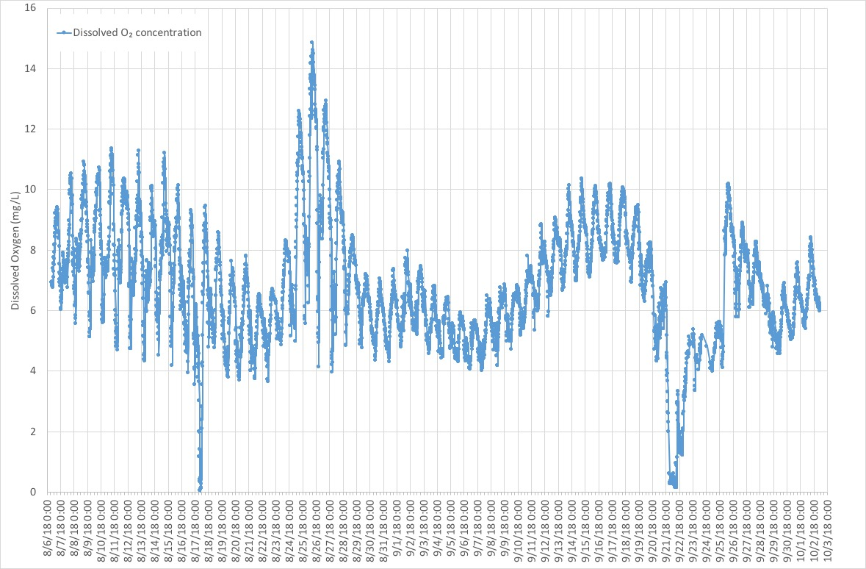
Remote Sensor Readings
Dissolved Oxygen Aug 6 – Oct 3, 2018

Slide 24
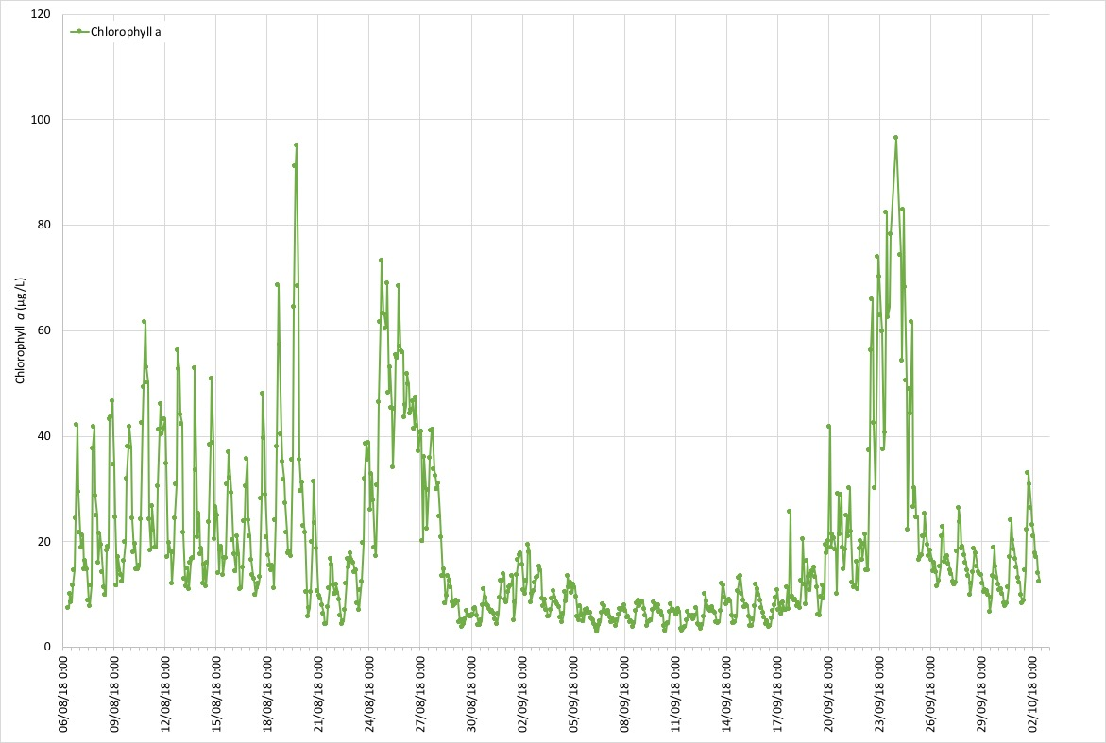
Remote Sensor Readings
Chlorophyll (Algal Biomass) Aug 6 – Oct 3, 2018

Slide 25
New Sensor Installations
Notes:
3 sensors purchased by the City, 1 purchased by the County

Slide 26
Phytoplankton/Pseudo-nitzschia Sampling Locations

Slide 27
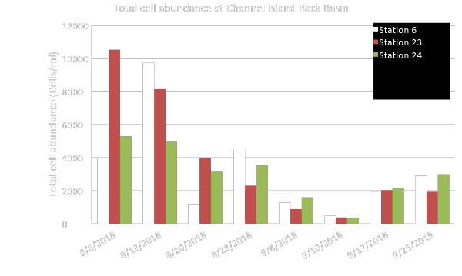
Phytoplankton Abundances
Notes:
Discuss how these results illustrate things have gotten better since the event in June

Slide 28
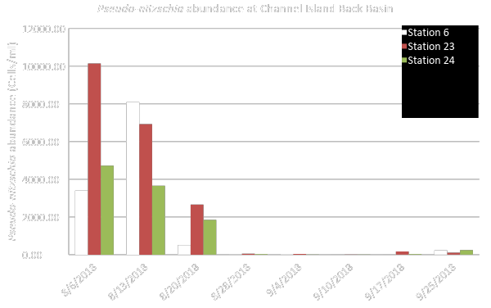
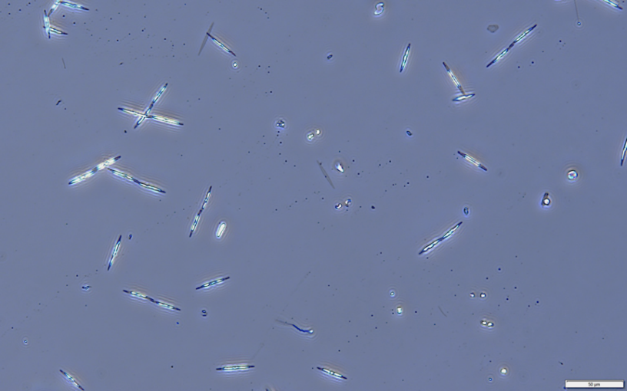
Pseudo-Nitzschia Abundances

Slide 29
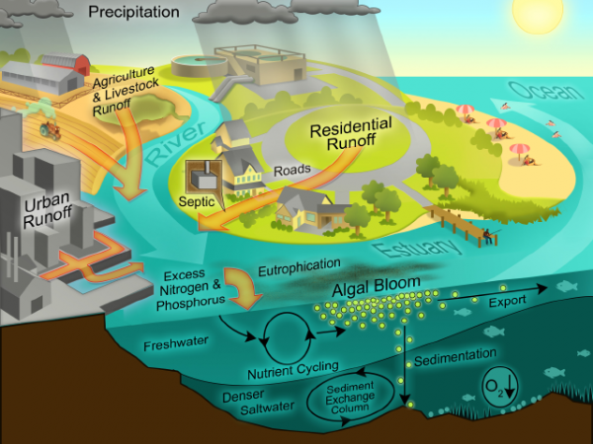
Nutrient Cycle

Slide 30
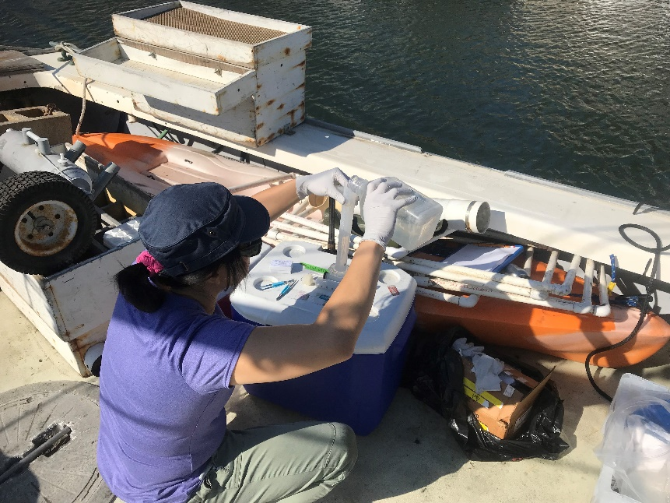
Nutrient Sources (Where are nutrients that may drive the problem coming from?)
Identify the possible nutrient sources to CIH
Focus on factors leading to low dissolved oxygen
Focus on nitrogen & phosphorus
(major stimulants of algal growth)
Boats
Residential
Agricultural
Aerial deposition

Slide 31
What is a Nutrient Source Study?
The study identifies sources and sinks of nutrients in the water and sediments of the Harbor
The components of the study include:
Sample
Measure
Identify
Investigate

Slide 32
What Does a Nutrient Source Study Include?
Sampling will include:
Initial baseline sampling (completed by City staff)
Two storm event samples at 30 locations in the Harbor and Edison Canal
Dry weather sampling
Sediment sampling

Slide 33
What Does a Nutrient Source Study Include?
Measure
Ammonia, nitrate, orthophosphate, total nitrogen and phosphorus
Bacteria: total and fecal coliforms, enterococcus
Review concentration of chemicals
Identify locations where nutrients or bacteria are elevated
Investigate the sources
Notes:
Feel free to expand if you want to

Slide 34
Possible Findings of Study
High phosphorus and nitrogen levels
High phytoplankton and low dissolved oxygen levels
Higher residence times due to poor circulation
High bacteria in dry weather
Maybe no one thing will be obvious

Slide 35
Possible Outcomes
High Phosphorous & Nitrogen
Residential Source Control
Reduce other sources of nutrients
Install Fans or Pumps
Education and/or regulation
Work with stakeholders and others

Slide 36
Possible Outcomes
High Phytoplankton
&
Low Dissolved Oxygen
Source control
High Residence Times &
Poor Circulation
Install fans or pumps
High Bacteria in Dry Weather
Enforce bilge dumping laws
Notes:
Be sure to mention that although these are some possibilities, without the studies we won’t know the solutions

Slide 37
Hydrology Study
To determine water’s residence time
8 weeks of work pending delivery of data
Notes:
City takes over at this point
As we continue with the study, we also need to begin this

Slide 38
Signs of a Potential Algal Bloom
If water sampling indicates increasing chlorophyll concentrations, this means an algal bloom is potentially forming and a low dissolved oxygen event might follow
Indications of a potential algal bloom: strong odor, surface scum, no visibility in the water, an odd color
Residents should report and send photographs of such indicators to ciharbor@oxnard.org

Slide 39
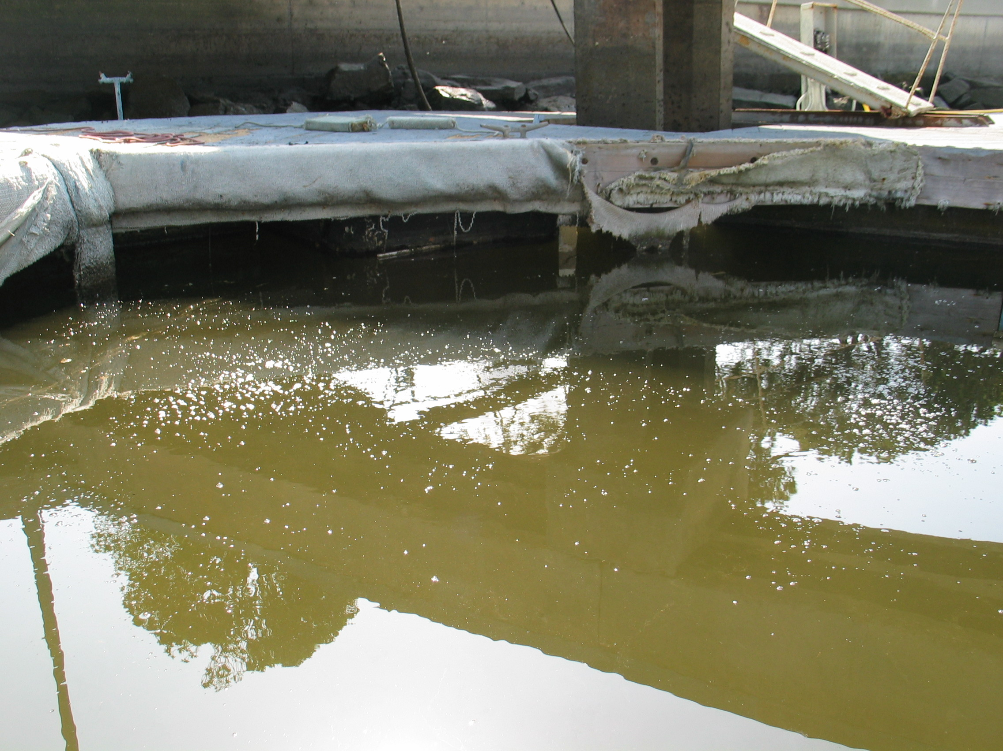
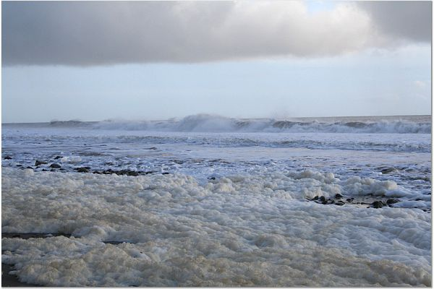
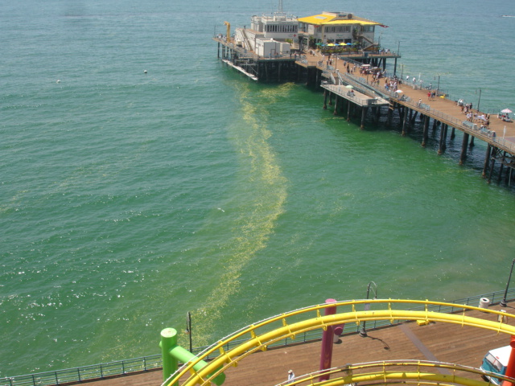
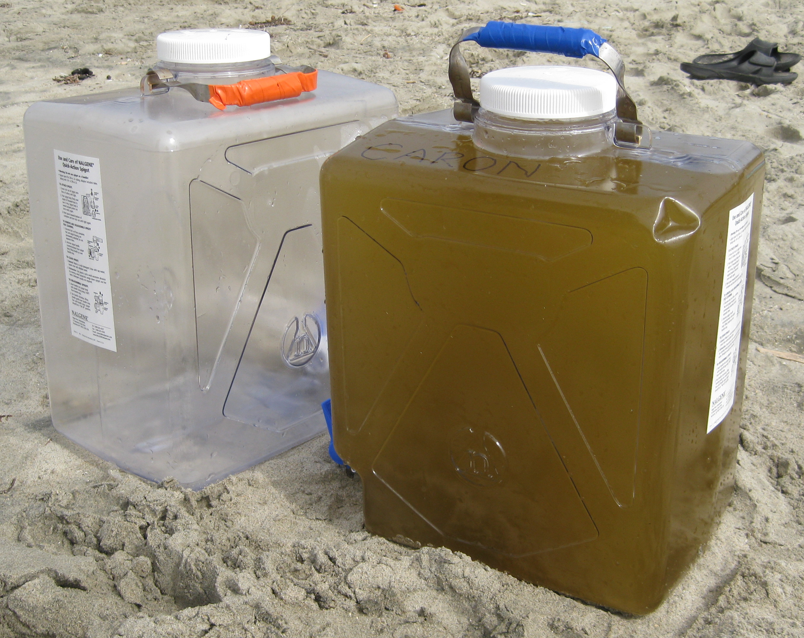
Algal Blooms can have many forms/appearances
Residents should report and send photographs of such indicators to ciharbor@oxnard.org

Slide 40
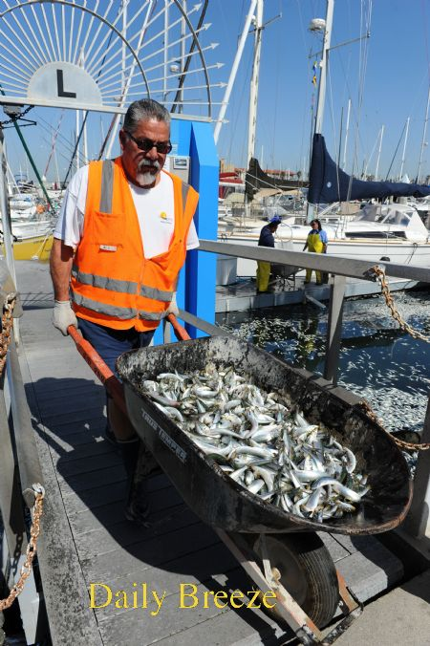
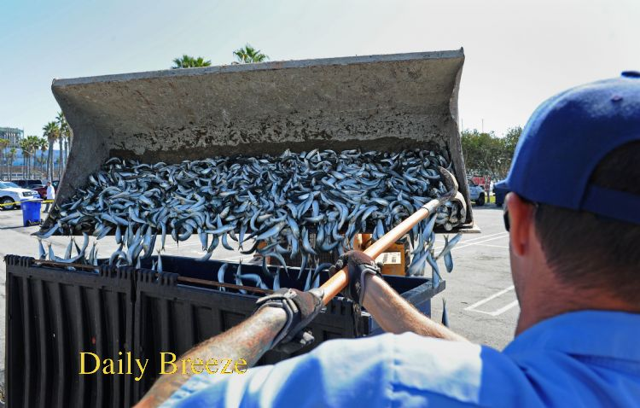
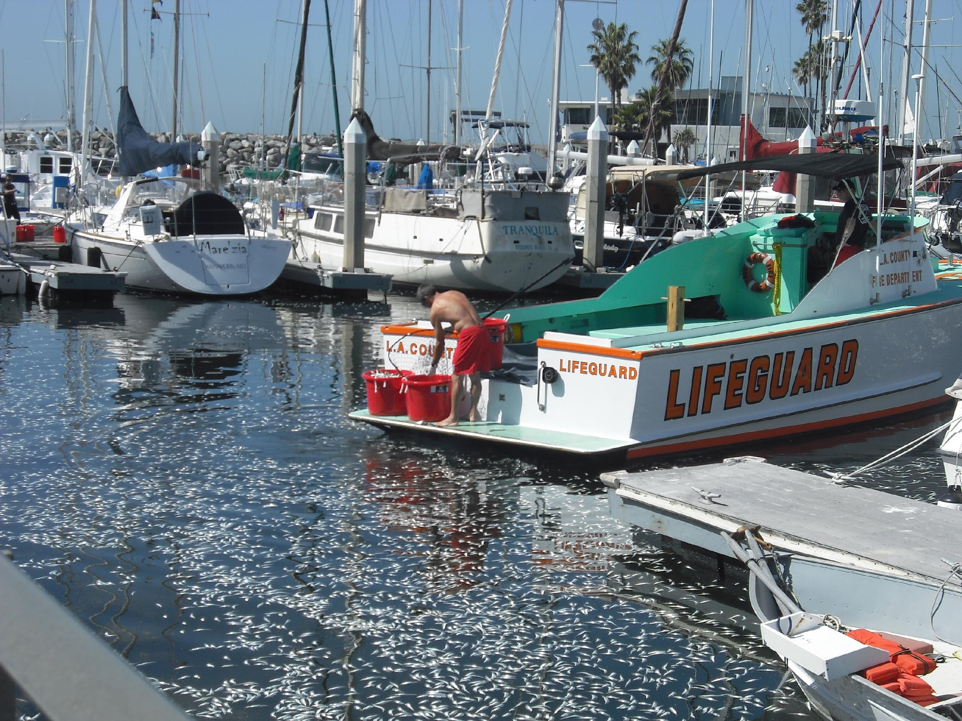
King Harbor, Redondo Beach
March 8, 2011
In the event of a fish kill…
The most important thing is to remove any dead fish as quickly as possible to avoid a follow up event
Notes:
Talk about King Harbor
Talk about impact of dead fish on BOD and nutrients

Slide 41
Response Plan for Fish Kill Event
Call to action for volunteers to develop the community action response plan to kick off in January 2019
Please sign up in the back tonight
Notes:
A plan will be put in writing and distributed with contact information

Slide 42
Keeping the Community Informed
Dedicated webpage: https://ww.oxnard.org/ciharbor
The City will call for meetings as needed with residents and other stakeholders
Email cih@oxnard.org

